Slide 1


‘
Beyond the Loom: Threading the Americas
Fundación Paiz Cultural Center, Guatemala City
January–March 2027
.

Slide 2
Fundación Paiz is a family-run, non-profit organization that supports art, culture, and education in Guatemala.
Established nearly 50 years ago, the Foundation is committed to the development and transformation of Guatemalan society through cultural and educational programs, most notably the Bienal de Arte Paiz.

Slide 3
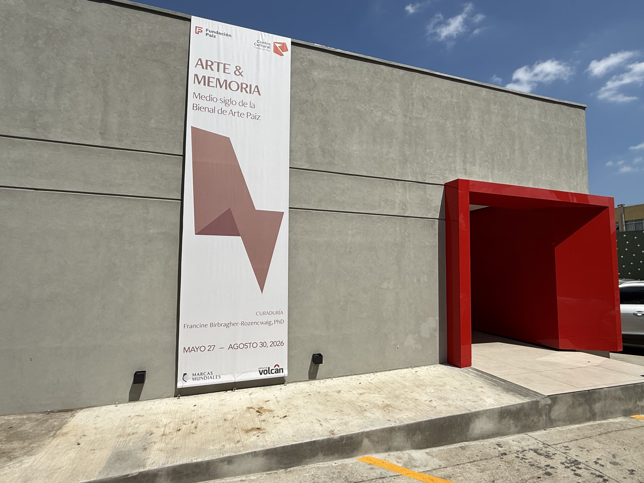
Fundación Paiz’s Cultural Center

Slide 4
Fundación Paiz’s Cultural Center
The Cultural Center, which opened to the public in May 2027, was built adjacent to the house that belonged to the grandparents of María Regina Paiz—current President of the Board of Directors of the Paiz Foundation—Carlos Benjamín Paiz Ayala, and Piedad Graciela Andrade Kelle, where the Fundacion Paiz’s offices are located.

Slide 5
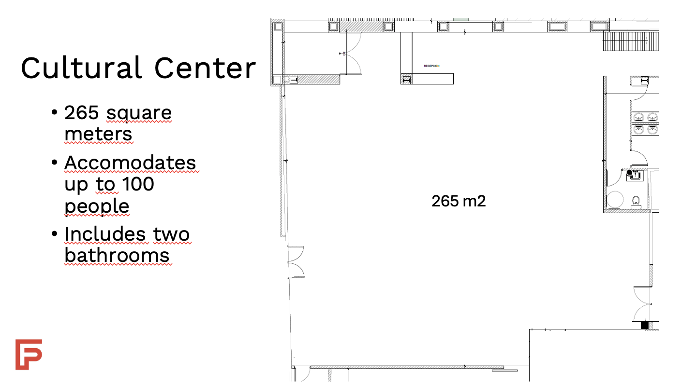
Gallery Space

Slide 6
Current exhibition
Art and Memory: Half a Century of the Bienal de Arte Paiz
The exhibition celebrates the history of the Biennial, which gave rise to the Paiz Art Collection.
From 1978 to 2008, the biennial was organized as a competition, and the winning works were added to the collection.

Slide 7
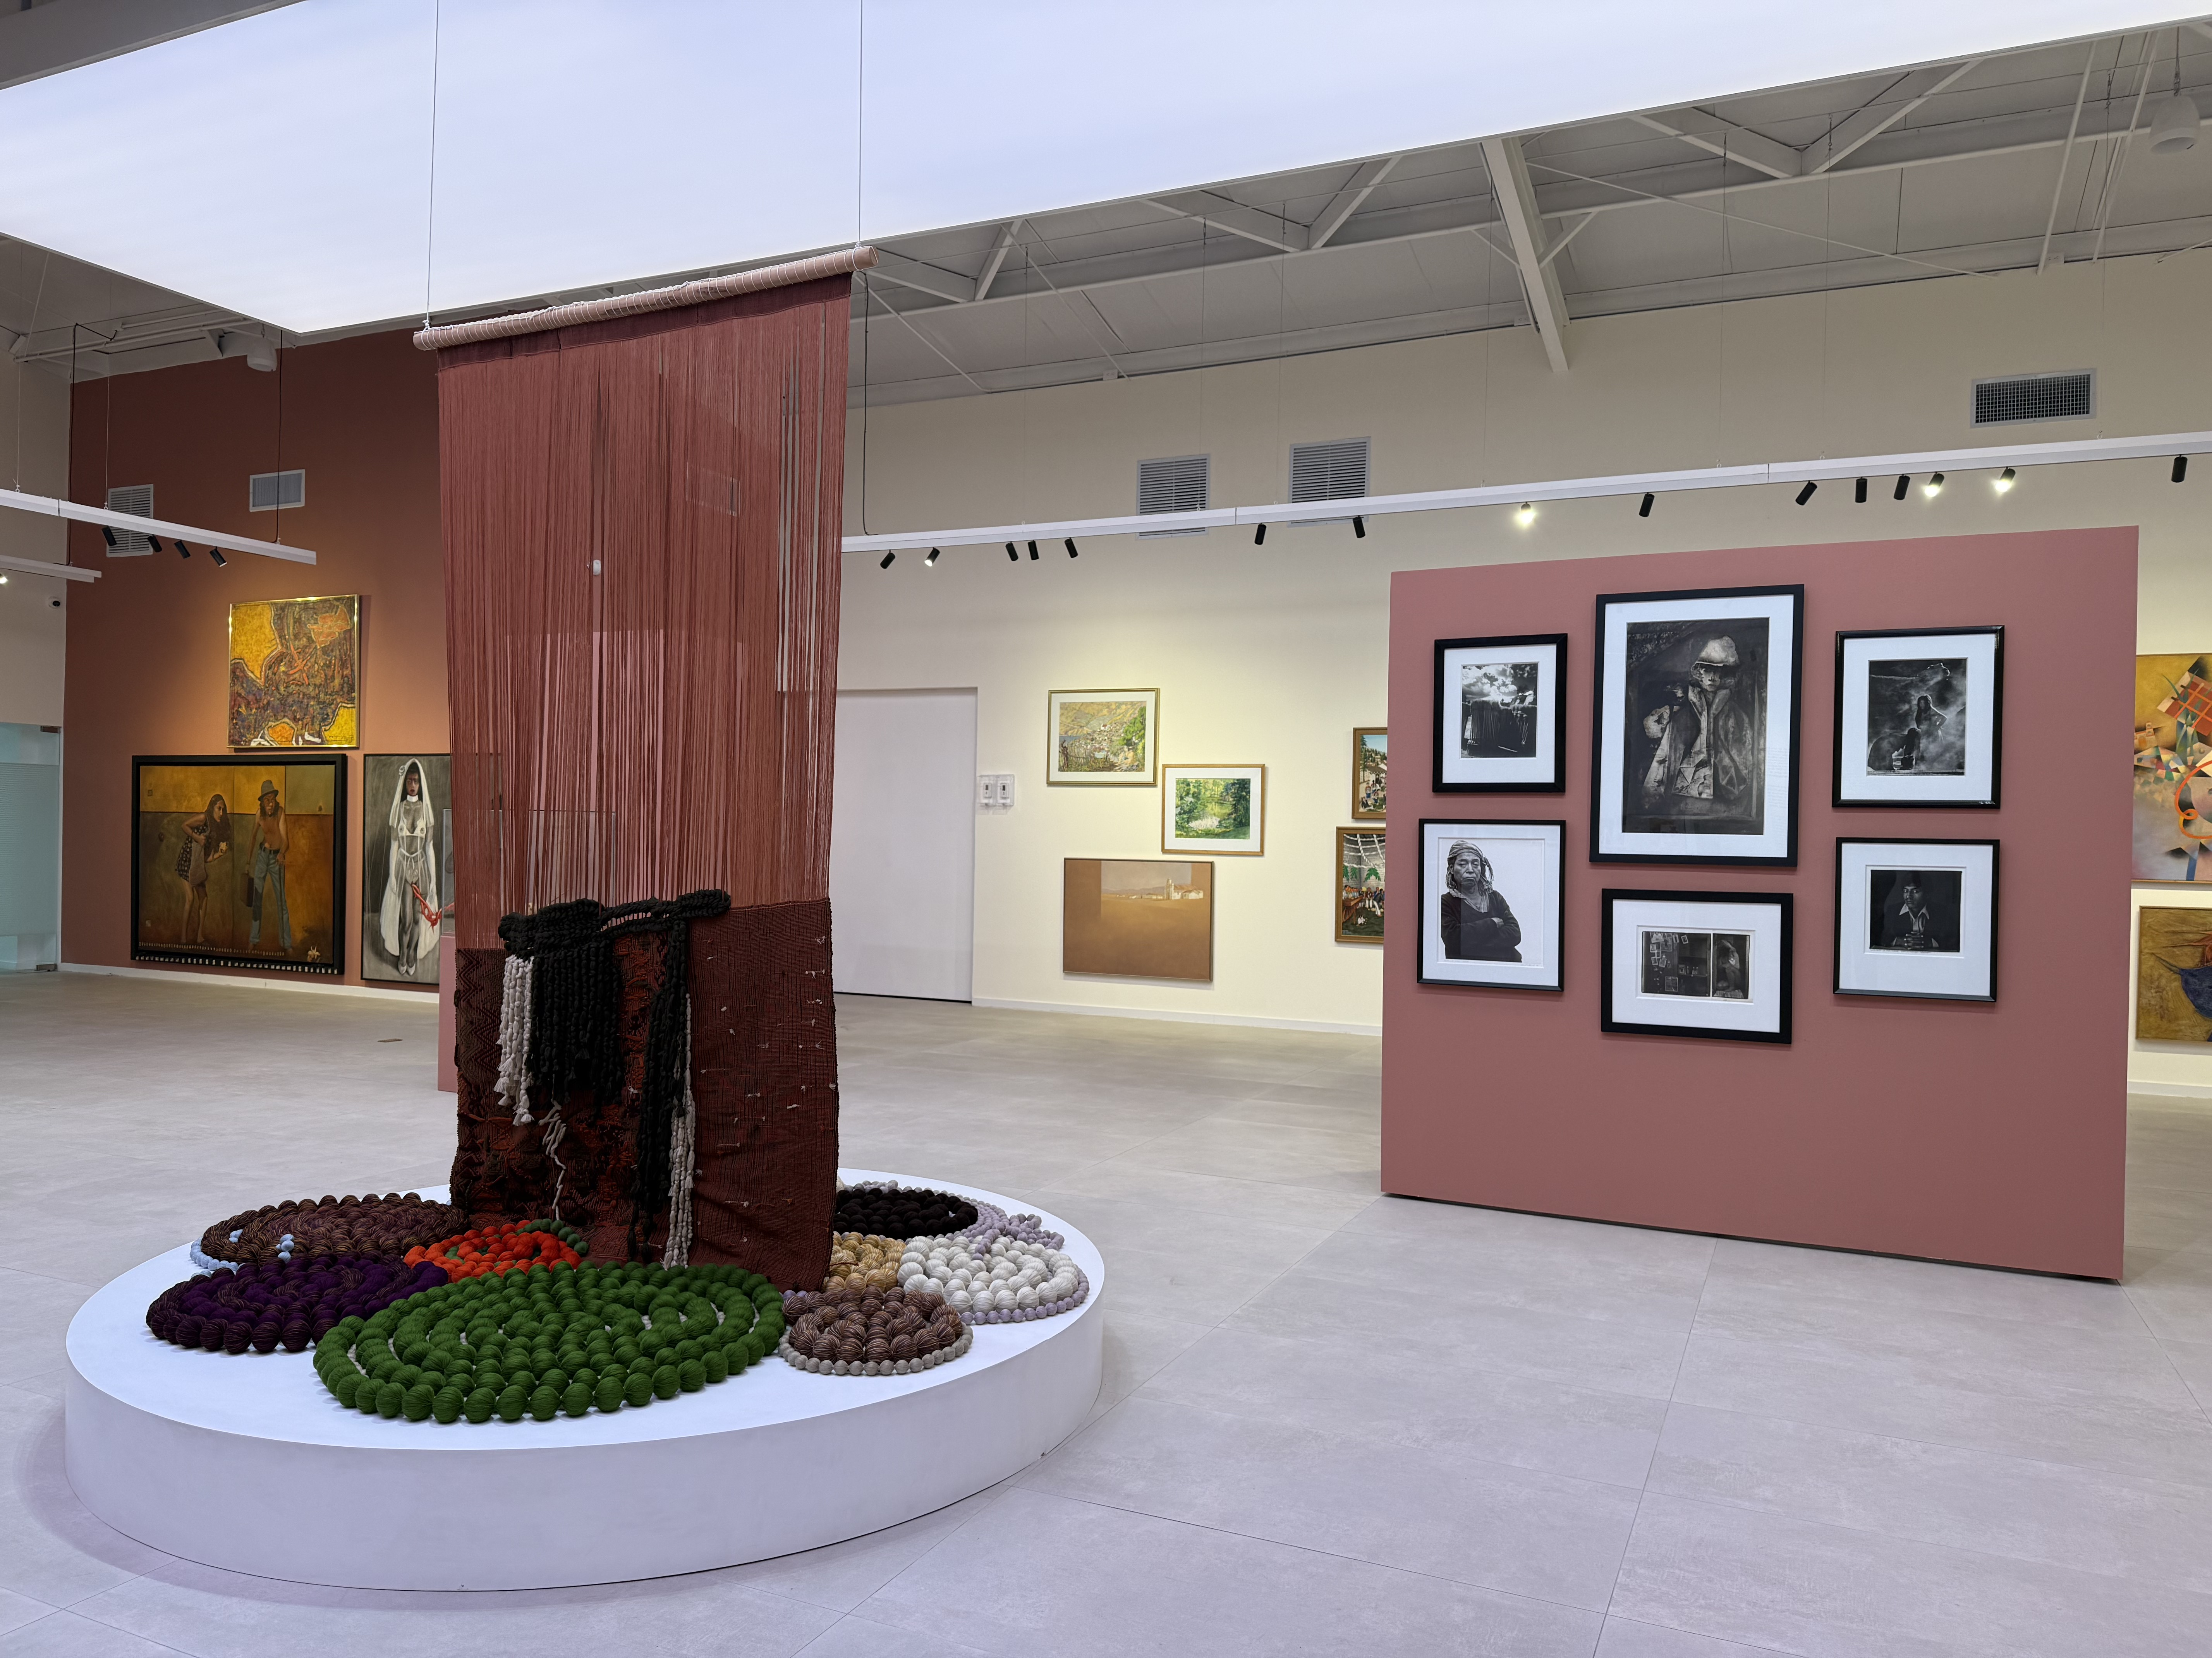
Art and Memory: Half a Century of the Bienal de Arte Paiz

Slide 8
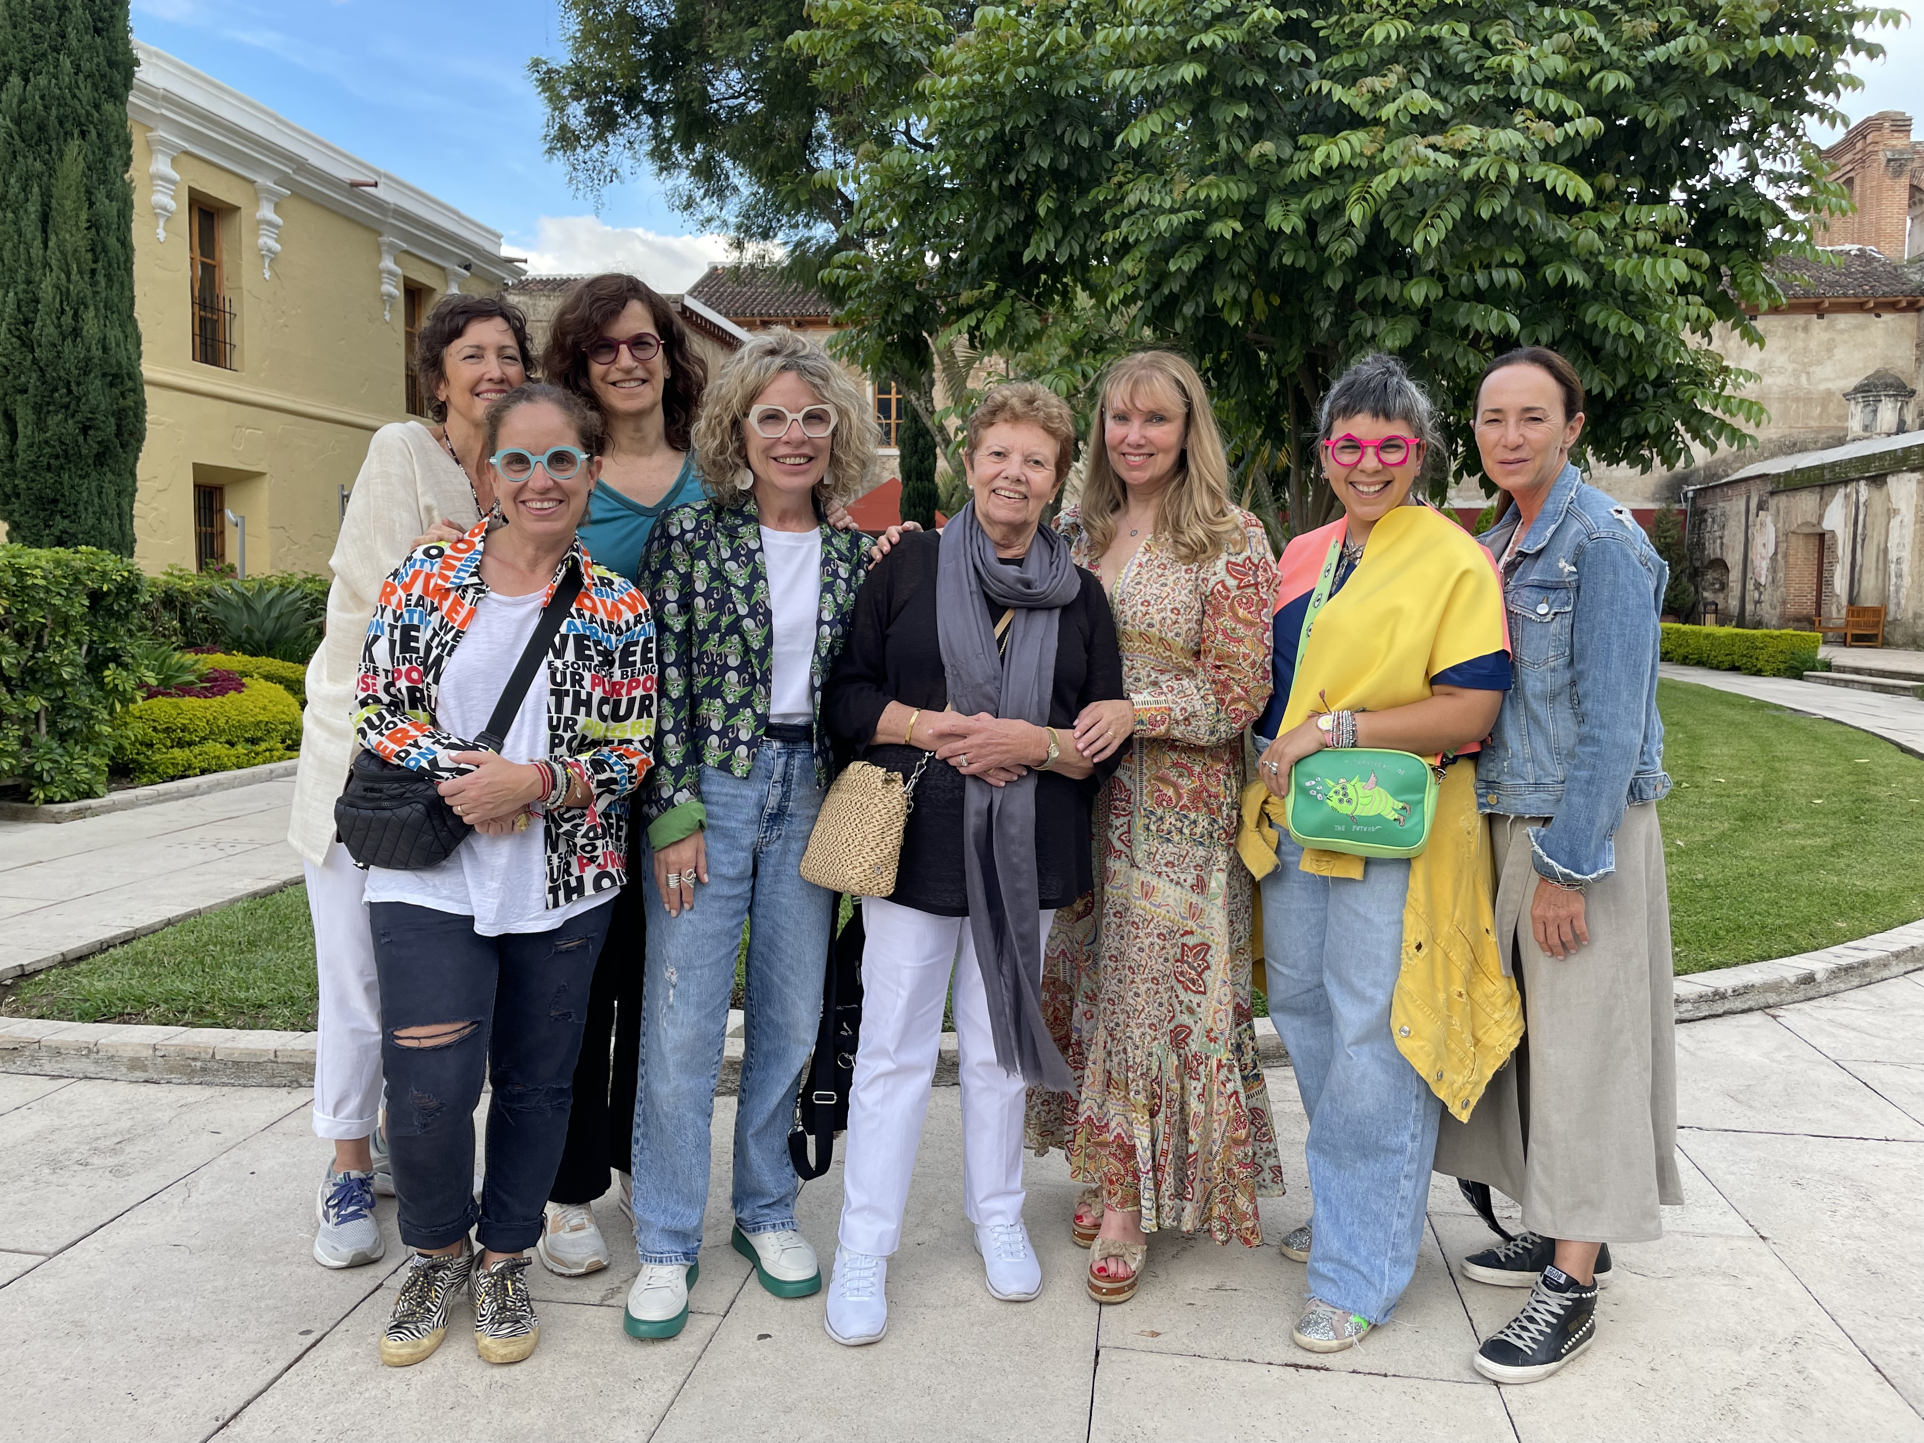
Fundación Paiz and Fiber Artists-Miami Association (FAMA)
23 Bienal de Arte Paiz, Ciudad de Guatemala-Antigua Guatemala, 2023

Slide 9
Beyond the Loom: Threading the Americas
The Fiber Artists Miami Association is collaborating with the Fundación Paiz to bring Miami’s diverse cultural landscape to the heart of the ancient Maya civilization in Guatemala.
Inspired by the vision and legacy of co-founder Evelyn Politzer, the project reflects FAMA’s ongoing commitment to fostering intercultural dialogue, artistic excellence, and meaningful community connections through textile art.

Slide 10
Beyond the Loom: Threading the Americas
The exhibition will take place from January to March 2027.
Curators: Aurora Molina, fiber artist and co-founder of FAMA
Francine Birbragher-Rozencwaig, Artistic Director,
Fundación Paiz

Slide 11
Objectives
Beyond the Loom will offer artists the freedom to interpret and respond to the rich textile traditions of Mayan weavers in Guatemala.
Drawing inspiration from their visual language, woven stories, cosmologies, landscapes, and ancestral lineages—expressed through color, geometry, weaving, and embroidery—the exhibition will celebrate textiles as living repositories of memory and identity.
It will pay tribute to these enduring traditions, where every motif embodies generations of knowledge, and every woven surface reaffirms the resilience, creativity, and cultural continuity of Mayan communities.

Slide 12
About the Artwork
Works will be displayed suspended from the ceiling or mounted on the wall (freestanding or floor-based sculptures are not accepted).
Proposals must be lightweight, easy to fold or pack, and suitable for international transport to Guatemala.

Slide 13
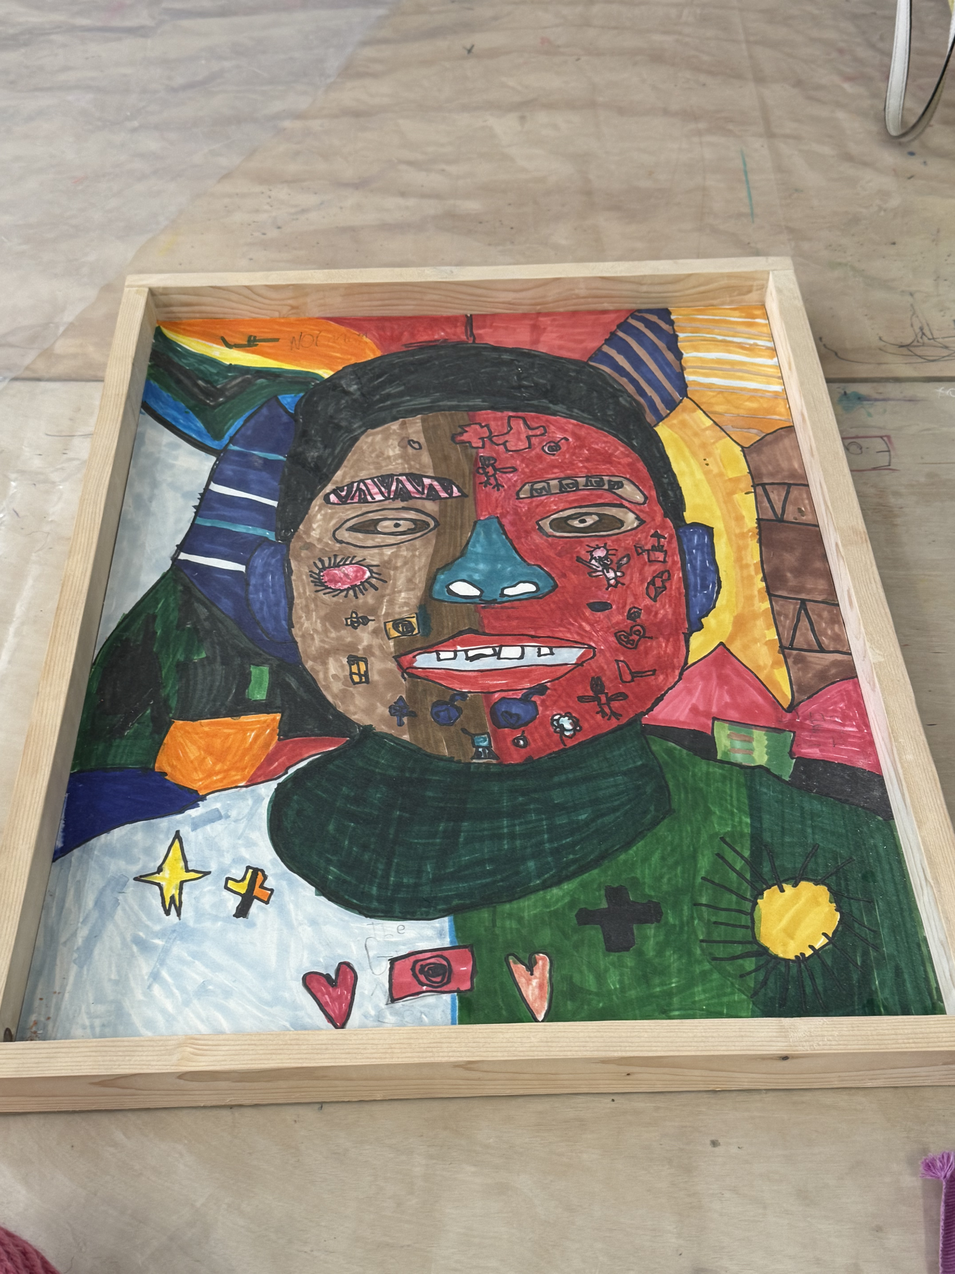
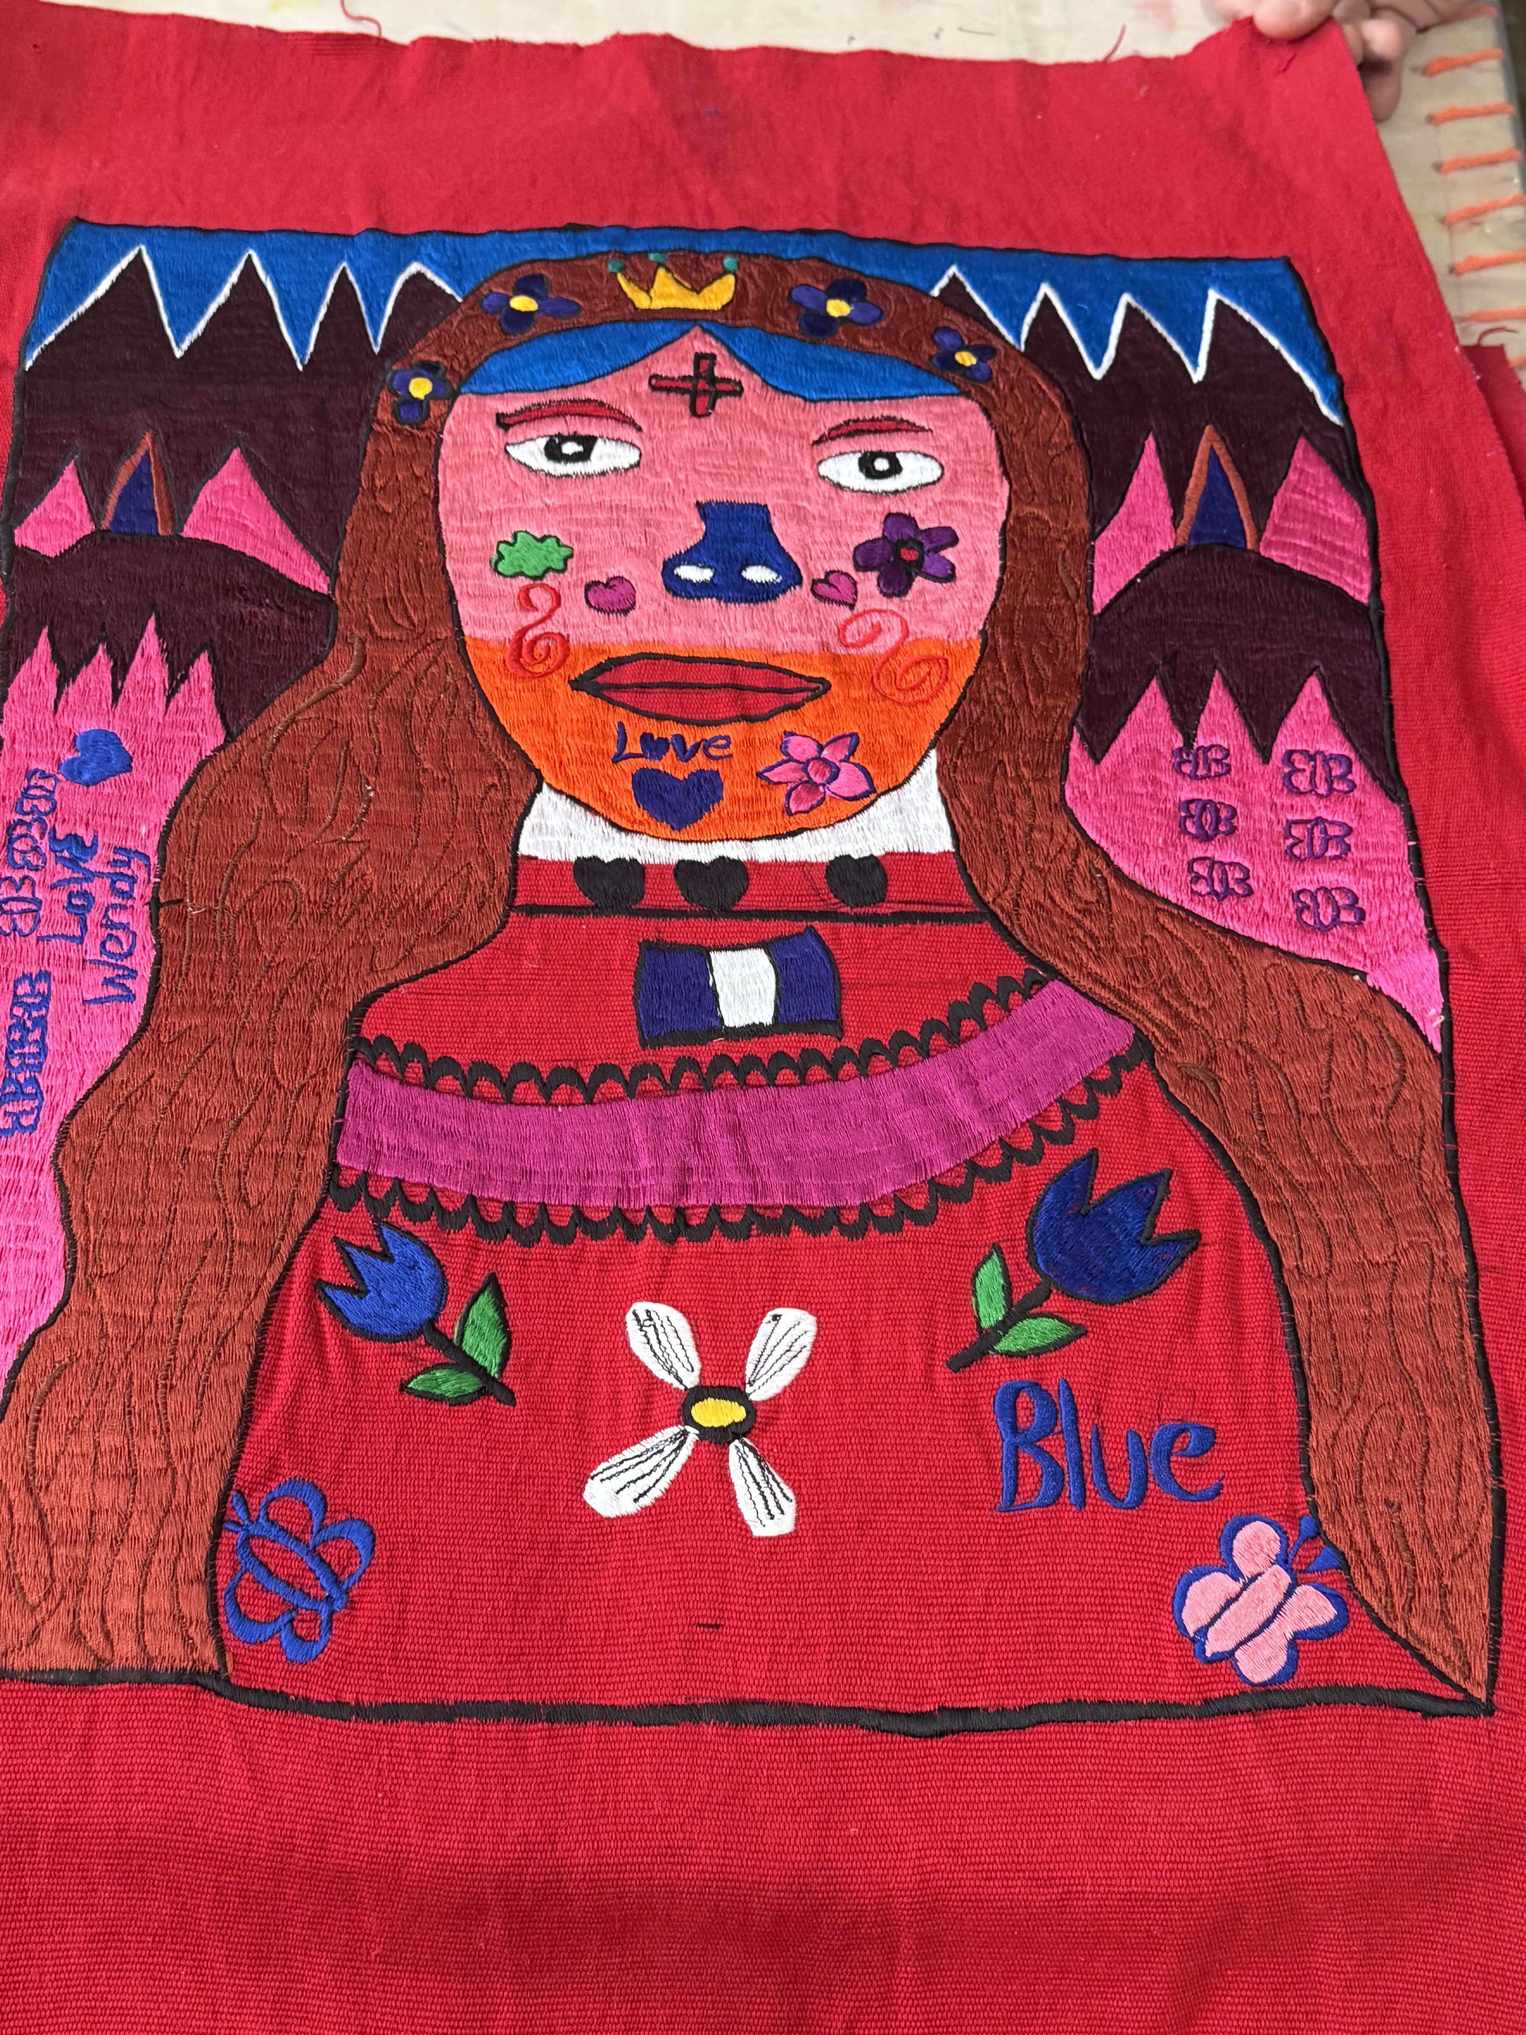
In addition to FAMA’s members artwork, the exhibition will include, within the exhibition, drawings and portraits resulting from Aurora Molina’s residency in Quetzaltenango.

Slide 14
Educational Programs
FAMA’s workshop in Quezaltenango, Saturday, January 16, 2027
Educational programs related to the exhibition organized by Fundación Paiz, including guided visits, talks, and workshops.

